Slide 1

Problem Definition
Sample Presentation:
this presentation reviews PROBLEM DEFINITITION, but also provides a model for your presentations and includes tips and suggestions to keep in mind as you design your own presentations.
The First Step in the Engineering Design Process
ENGR 120, Spring 2022

Slide 2
Overview
TIP: Provide a ”roadmap” so your audience knows what to expect.
Hyman’s Problem Formulation Model* with Example
NEED
GOAL
OBJECTIVES
CONSTRAINTS
* Source: B. Hyman, “Problem Formulation,” in Fundamentals of Engineering Design, Prentice Hall, 2002, pp. 40-54.

Slide 3
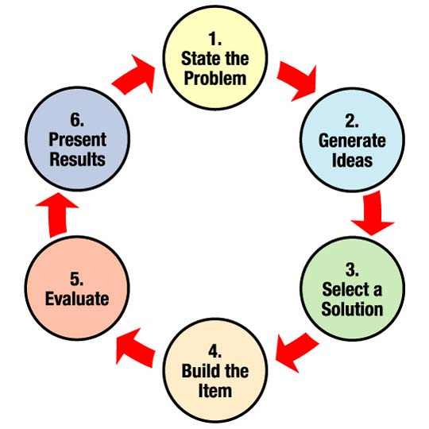
The First Step in the Design process
SHOW
as well as
TELL.
Provide visuals to illustrate your ideas whenever possible
ENGINEERING is PROBLEM-SOLVING
Everything you do will require you to start by defining the problem.
TIP: include a “power statement” WHY IS THIS IMPORTANT to your AUDIENCE? (You can do this on the title slide as well)
In ENGR 110, you got to stage 3 of this process.
In ENGR 120, you will complete the entire design process (by building a prototype design).

Slide 4
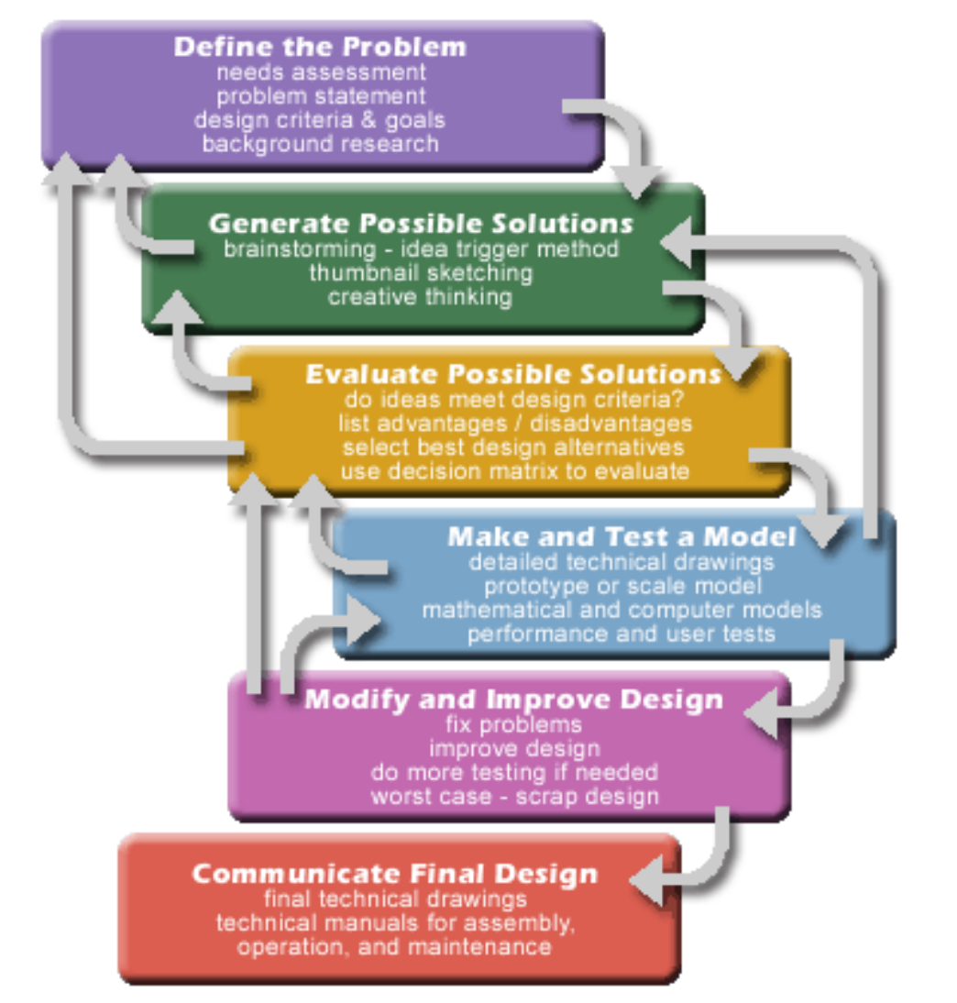
Before you can offer a solution, you must show that you fully understand the problem:
Need assessment: what is the “unsatisfactory situation”?
Problem statement (or Goal): What general, overall goal do we want to achieve? What would an improved or “satisfactory situation” look like?
Criteria/requirements/ specifications: what measurable objectives should any solution try to achieve? What constraints must any solution abide by?
Background Research: what data do you have that shows the effects of the problem?
NOTE:
The design process is iterative.
Include sources for images you did not create yourself
Image Source: http://engineering.tufts.edu/ggs/designprocess.htm

Slide 5
Hyman’s problem formulation model
NEED
A description of the unsatisfactory situation
Avoid jumping to a solution here
GOAL
The genera, overall desired result.
OBJECTIVES
Measurable “grade-able” criteria for evaluating solutions.
CONSTRAINTS
Can also be things like space or size limitations, range factors, etc.
Factors that LIMIT solution options (typically things like budget, timeline, regulations, etc).
If you compare possible solutions, one might higher overall score or grade because it is better at meeting objectives.
A description of what the situation would be like if an effective solution were put in place.
These are PASS/FAIL CRITERIA for solutions.

Slide 6

Need Statement
Section Heading Slide: indicates a new sub-topic.
Consider whether you really need to include these in a short presentation.
Defining the “Unsatisfactory Situation”

Slide 7
Developing a Need statement
“I am paying a fortune in heating bills!”
I need a new furnace in my house.
If presenting to a live audience, build in opportunities for interaction and engagement whenever possible.
What is wrong with this need statement?

Slide 8
Revised Need Statement
“My heating system is inefficient, and therefore my heating bill is too high.”
A well-crafted Need Statement briefly describes the unsatisfactory situation:
It can be fairly general
It can be supported by data (you can show heating bills over the last few months/years to show the extent of the unsatisfactory situation.)
It allows a range of possible solutions
It does not presume any single solution (such as a new furnace)

Slide 9
NEED: Key points
Summarize “key take-aways” from this section before starting the next section
NOTE:
There is a lot of text here… but this is a “teaching slide” meant to be reviewed, not just watched once. So I have included more text than you would normally have on a presentation slide.
The solutions we develop depend largely on how we define the NEED for a solution (or “unsatisfactory situation”).
The client does not always define the NEED effectively; they often jump to solution ideas too quickly
Follow up with questions and do your own research
Think broadly first, then narrow down solution ideas. Avoid fixating on a single solution.

Slide 10

Goal
NEW SECTION slide (consistent format with previous section slide)
Developing a Goal Statement

Slide 11
Goal statements
Where the NEED statement is a negative statement of the unsatisfactory situation, the GOAL statement is simply the opposite. It is a positive statement of what the SATISFACTORY situation would be like, once a solution is put in place.
FOCUS is key!
A very general goal statement allows for a broad range of solutions, but may make it difficult to find an approach.
A more narrow goal statement limits the potential solution ideas, but makes it easier to focus.
AUDIENCE ENGAGEMENT Strategy:
What are some possible GOAL Statements for our home heating problem?

Slide 12
Sample Goal statement
“My goal is to find way to heat my home more efficiently and cost effectively.”
Is it fairly general?
Can it be supported by data? (you can show heating bills
Does it allows for a range of possible solutions?
Does it avoid jumping to a single solution (such as a new furnace)?

Slide 13


Objectives
Designing Quantifiable Expectations of Performance for Evaluating Alternative Solutions

Slide 14
Objectives
Objectives are ”quantifiable expectations of performance” that allow you to evaluate how well any solution fulfills the need and goal.
they are “grading criteria” for evaluating the effectiveness of solutions.
It is crucial to establish objectives BEFORE considering solutions (to avoid bias).
NOTE: How would you like to be graded on an assignment without knowing what the evaluation criteria are? Or apply for a job without knowing the job description or hiring criteria?
You cannot develop a solution until you know what objectives it is supposed to achieve, and how they will be measured.
Q: What objectives should any solution to our home heating problem try to achieve?
Provide examples or analogies that your audience can relate to

Slide 15
Example Objectives
Give specific examples to explain the concepts
GOAL: improve efficiency and cost effectiveness of home heating system
OBJECTIVES: any proposed solution should
Reduce annual heating bill (by a measurable amount, such as at least 15%)
Increase heating efficiency (by a measurable amount such as at least 25%)
Maintain consistent comfortable temperature in the home (preferred temperature ranges)
Be cost effective (measured in dollars, cost savings, pay-back or return-on-investment period, etc.)
NOTE: all objectives are easily measurable and quantifiable. Solutions can be ranked by how well they meet objectives.

Slide 16
Objectives and the “Target zone”
Illustrate your ideas visually
High score – “bullseye!”
Good score
Ok score
Low score
Scoring for Objective 4: Be cost effective
Score | Measurement $ CND
5 | 0 – 2,000
4 | 2,001 – 4,000
3 | 4,001 – 6,000
2 | 6,001 – 8,000
1 | 8,001 – 10,000
Each objective is a slice of the target
Outside the “target zone” does not abide by constraints = FAIL (zero)
Budget constraint = Max $10,000 CND. Solutions that cost more than $10,000 cannot be considered.

Slide 17
Sample Objectives Table
You must make a scoring rubric for each objective.
Objective | Basis for Measurement | Units
Reduce annual heating bill by at least 15% | Utility bills (Meter reading) | Dollars (CND)
Increase heating efficiency by at least 25% | Measure heat loss at windows and doors with a Blower Door Test | Change in Air flow rate in Pa
Maintain consistent comfortable temperature in the home | Range of temperature reading from thermometer in centre of the home | Degrees Celsius
Be cost effective | Cost of implementation and maintenance | Dollars (CND)
ENGAGE: have audience help make a scoring chart for one objective

Slide 18

Constraints
Identifying factors that limit your solution options

Slide 19


Constraints
Constraints are limiting factors such as
Permissible conditions of design features
Permissible range of design and performance parameters
Where OBJECTIVES are ”grade-able” (you can evaluate how well a solution achieves an objective), CONTRAINTS are pass/fail conditions.
Any solution MUST meet these conditions or it cannot be considered a feasible solution.
Objectives | Constraints
A+ | Pass
B (etc) | Fail

Slide 20
Common Constraints
ENGAGE: Brainstorm some possible solutions that would NOT abide by constraints.
Budget: I can spend a maximum of $10,000 on improving my home heating
(or: Solution must have a payback period of less than 20 years)
Time: the solution must be fully implemented no later than December 31, 2022.
Space: the solution cannot require any significant renovation to the home that would require a permit or variance. Any new appliances must fit in a 4’x4’ space in the basement utility room.
Regulations: the solution and its implementation must abide by all municipal, provincial and federal laws, regulations, and safety standards.
Energy Rating; any appliance solution must have an Energy Star rating.

Slide 21

Put it all together
Connect the dots for your audience. Provide “key take aways” or “big picture” perspective
Sample Problem Definition

Slide 22
Home Heating Problem Definition
Need
Home heating bill is too high
Goal
Improve home heating energy efficiency and cost
Objectives
Cost no more than $10,000 and be complete by Dec. 31, 2021
Constraints
reduce heating bill by at least15%
Increase heating efficiency (reduce heat loss) by at least 25%
Maintain consistent comfortable home temperature
Follow all laws, rules, guidelines and meet Energy Star standards
Fit in my utility room (4’ x 4’ space) or not require significant reno
Be cost effective

Slide 23
NEXT steps
Come back to your opening context to place the ideas in the larger perspective for your audience
Now that the problem is clearly and thoroughly defined, you can proceed to step 2:
Start brainstorming solution ideas!

Slide 24
You Try
Provide a final slide with:
References
Additional resources
practice activities
Or whatever seems most helpful to conclude with.
Read Chapter 1.1 Problem-Solving Approach to Communications Tasks to review this information on formulating a problem definition.
Do exercise 1.2 at the end of the chapter
Submit your work to the Problem Definition Discussion Forum on our course Brightspace. Give feedback to at least 3 of your classmates on how well they followed the problem formulation model we have covered here and what changes they may need to consider. Revise your own, taking feedback into account.

